Slide 1
At Home and Abroad: Prosperity and Depression
1917-1940

Slide 2
Objective
The 1920s have been characterized as a decade of economic, social, and cultural change. Analyze the extent to which the First World War and consumerism affected United States society during this period.

Slide 3
War and Prosperity: 1917-1929
The 1920’s were a time of many changes in the economic and social aspects of life in the US
Following WWI, the US struggled to return to what President Harding called “normalcy”
However the impact of the war, the new age of consumerism, the automobile and the growth of suburbs contributed to the creation of a different and new national lifestyle

Slide 4
War and Prosperity: 1917-1929
While transportation and communications technology served to unite the nation, a clash of values between the new urban-centered life and the legacy of the traditional rural life caused uneasiness and conflict
In addition, all Americans did not share in the good times
Beneath the surface was an economy with structural flaws that brought the Roaring Twenties to an abrupt end with the stock market crash in October 1929

Slide 5
The Big Idea
In the 1920’s
The American people attempted to return to “normalcy” in foreign and domestic affairs
New technologies created a consumer goods economy based on mass consumption
The nation became increasingly urbanized, modernized and commercialized
American society was unsettled by these rapid economic, social and cultural changes
Tensions developed between new and traditional lifestyles, nativism resurfaced
A boom economy was not shared by all Americans and it came to an end with the 1929 stock market crash

Slide 6
The Impact and Aftermath of War
US after the war
American economy slows as wartime production ends
Returning troops face difficult adjustment to civilian society
Many women and minority workers face loss of jobs as men return to workforce

Slide 7
The Impact and Aftermath of War
US after the war
Despite contributing to war effort, returning African American troops continue to face discrimination and segregation
Death and destruction of war leads to feelings of gloom among many Americans

Slide 8
The Impact and Aftermath of War
World War I triggered a number of important changes in American society, most notably for some women and for many immigrants and African Americans
Some changes were subtle and gradual while others were immediate and dramatic

Slide 9
Effects on Women and Minorities
As many men went off to fight in Europe, the roles and responsibilities of women were affected
Their family responsibilities increased
They contributed to the war effort as volunteers
Some women went to work in male-dominated fields, such as weapons factories
Many women served overseas with the Red Cross and the Salvation Army

Slide 10
Effects on Women and Minorities
Most, however, worked in traditionally female jobs, for which there was an increased demand
Only about five percent of the women entering the wartime workforce were new to work outside the home
At war’s end, with the return of male workers, women were expected to quit their jobs or return to more traditional female work
Between 1910 and 1920, only 500,000 more women were added to the workplace

Slide 11
Effects on Women and Minorities
The war had harsh consequences for immigrant families
Further immigration to the US came to a halt
About 18 percent of the American troops were foreign-born
Yet, many immigrant families already in the country faced fierce social and job discrimination in an antiforeigner climate whipped up the war
Most African American civil rights leaders supported WWI, and some 400,000 African American troops served in it
African American soldiers were assigned to segregated units that often worked as laborers
Discrimination was common

Slide 12
Effects on Women and Minorities
Where they saw combat, African American soldiers served with distinction
Several African Americans regiments fighting alongside of French troops were honored by the nation
Many returning African American soldiers questioned why the liberties and freedoms they had fought to preserve in Europe were denied them in their own country

Slide 13
Migration to the North

Slide 14
Migration to the North
WWI accelerated the migration of African Americans to northern cities
This migration began after the Civil War
From about 1910 to 1920, southern agricultural jobs were lost to floods and to crop damage
About 500,000 African Americans moved from the South to jobs in the industrial North
Meanwhile, in the North, workers were needed to meet war production goals
The flow of immigrant labor was ended by the fighting, creating an additional need for workers to replace those in uniform

Slide 15
Migration to the North
After the war, this Great Migration continued
Between 1910 and 1930 and again in the 1940’s, almost 2 million African Americans left the South
Although they were usually able to improve their economic situation, they were still faced with discrimination and segregation
Competition for jobs and housing produced racial tensions that at times led to individual violence and riots

Slide 16
The “Return to Normalcy,” 1918-1921
After WWI, disillusioned Americans wanted to return to the traditional foreign policy of isolationism
The 1920 landslide election of Republican President Warren G. Harding and VP Calvin Coolidge represented the desire of many Americans to remove themselves from the pressures of world politics and idealistic goals of the Progressives
While Progressivism continued, it was at a slower pace and reforms took place largely at the state and local levels

Slide 17
The 1920’s: Business Boom or False Prosperity?
Greed and Scandal Under Harding
Harding was an Ohio newspaper publisher with little experience in politics. Historians credit him for pardoning socialist Eugene V. Debs (who had been jailed for opposing the war) and for supporting antilynching legislation. Harding appointed some dedicated people to office, including Charles Evans Hughes as secretary of state
However, the president also gave political jobs to members of the so-called Ohio Gang, corrupt associates who took advantage of him. After Harding’s death in 1923, the public learned of several scandals during his administration
For many Americans, postwar did return to normalcy. Yet beneath the surface, troubling political and economic problems had begun to develop

Slide 18
Greed and Scandal Under Harding
Theft: The head of Veterans Bureau was convicted of selling hospital supplies for his own profit. He was imprisoned and fined
Fraud: The Alien Property Custodian was imprisoned for selling former German property for private profit
The Teapot Dome Scandal: Secretary of the Interior Albert Fall was convicted of accepting bribes from two oil executives in exchange for allowing them to lease government-owned petroleum reserves. One of the oil fields was at Teapot Dome, Wyoming

Slide 19
“The business of America is business”

Slide 20
Under Coolidge, Prosperity for Some
Calvin Coolidge became president when Harding died in office in 1923
In the 1924 election, Coolidge was returned to office
Coolidge is best known for his laissez-faire approach to the economy and his strong commitment to business interests
Coolidge retained financier Andrew Mellon as Secretary of Treasury
Mellon acted on the philosophy that government’s role was to serve business

Slide 21
Under Coolidge, Prosperity for Some
Recession
Recovery
The end of WWI was followed by a recession caused by the shift from a wartime to a peacetime economy
Production, farm income, and exports fell
Unemployment rose, reaching 11.7 percent in 1921
For farmers, in particular, hardship continued throughout the decade
In other sectors of the economy, however, a period of economic recovery had begun by 1923, when Coolidge became President
The years between 1923 and 1929 were seen as a time of booming business
The Gross National Product (GNP) rose 40%
Per capita income went up 30%
With little inflation, actual purchasing power – and therefore the standard of living – increased
At the time, few people questioned this Coolidge prosperity

Slide 22
Pro-Business Policies
Business and the wealthiest citizens were helped by tax laws that reduced personal income tax rates, particularly for upper income groups, removed most excise taxed, and lowered corporate income taxes
The government reduced the national debt and balanced the budget by raising tariffs and demanding repayment of war debts
Tariff rates were raised in return to protectionism. Republicans argued that higher tariffs would limit foreign imports, thus protecting US industry and agriculture from foreign competition, but the actual effect was to weaken the world economy
Regulatory agencies such as the Federal Reserve Board, the Federal Trade Commission and the Interstate Commerce Commission were staffed with the people who saw their role as assisting business rather than regulating it
A relaxed attitude toward corporate mergers was supported by the executive branch and by the Supreme Court. By 1929, about 1,300 corporations produced three fourths of all American manufactured goods, and 200 companies owned half of the nation’s wealth
Some groups, especially big corporations and the wealthy, benefited greatly from Coolidge prosperity.
For example:

Slide 23
Economic Boom Bypasses Other
Coolidge prosperity was not for everyone
Key Segments of the population failed to share in the general rise in living standards
Labor
Strikes had dropped sharply during WWI, mainly because the Wilson government supported collective bargaining in return for a no-strike pledge
Membership in the AFL grew, and wages for was industry employees rose sharply
However, inflation wiped out any real gains in buying power

Slide 24
Labor
The 1920’s saw a reversal of any union gains
Strikes in the steel, mining and railroad industries, in part because the government used not only troops to end the strikes but also injunctions, which are court orders that prohibit specified actions
The Supreme Court also ruled against child labor laws and against minimum wages for women and children
In addition, some companies began to offer health and life insurance in hopes of lessening workers’ interest in unions
The strategy often worked – Membership in labor unions fell from a high of about 5 million in 1921 to under 3.5 million in 1929

Slide 25
Labor
While the labor movement weakened in the 1920s, conditions improved for many workers
After 1923, unemployment averaged 5% or less
Worker productivity rose over 40%
In general, however, real wages of workers increased only slightly during this period , boosted primarily by wages of workers in the new industries such as communications and automobile manufacturing
This situation meant that they could not afford to buy many of the new consumer goods

Slide 26
Farmers
The only farmers to benefit from Coolidge prosperity were those involved in large commercial operations
Small farmers were hurt by a combination of factors

Slide 27
Farmers
Farmers expanded production during WWI in response to rising prices and the demand for food. They added to their acreage and brought more farm machinery
New machinery and new farm techniques increased farmers’ crop yield per acre
After the was, when European farms began producing again, American farmers were growing too much. With overproduction the prices of both farm products and farmland decreased dramatically
Net farm income feel 50% during the 1920s. As farm income fell, many farmers lost their land when they could not make their mortgage payments. As a result, the number of farmers declined, too. By 1930, only about 20 percent of the labor force made a living farming

Slide 28
Economic Boom Bypasses Other
Native Americans
African Americans
During the 1920s, Native Americans had the highest unemployment rate of any group and the shortest average life span
Most lived on reservations, without the basics, such as heat and running water
African Americans who migrated to the North enjoyed a higher standard of living than in the South
However they still earned less than white workers and experienced a higher rate of unemployment

Slide 29
Stock Market Speculation
The economic recovery helped produce a surge of investment in the stock market
Optimistic business and government leaders saw no end to the boom
They encouraged everyone to play the bull market- that is, the rising stock market
Some families invested their life savings
The profits rolled in – for a while

Slide 30
Stock Market Speculation
Yet the new wealth flowed from a stock market with a deeply flawed structure
This meant that buyers could purchase stocks by making only a small down payments in cash – sometimes as low as 5% of the value of the stocks
They borrowed the rest from brokers and counted on their profits to repay the loans
The system worked as long as the profits continued

Slide 31
Mass Consumption
The 1920s were a time of mass consumption – huge quantities of manufactured goods were available, and many people had more money to spend on them

Slide 32
Effects of New Industries on American Life
The Automobile Industry
1. Stimulated the steel, rubber, paint, glass and oil industries
2. Accelerated a middle-class move to the suburbs that fueled a real estate boom
3. Led to an increase in highways and a decline in railroad construction and use
4. Caused tractors to replace horses on farms
5. Increased social equality as low prices made cars available to Americans at almost all income levels
6. Stimulated installment buying
7. Contributed to growing sophistication of advertising techniques
8. Expanded cities into larger urban areas
9. Stimulated development of services such as gas stations, motels, supermarkets and shopping malls
10. Gave greater independence to women and teenagers, changing family life

Slide 33
Effects of New Industries on American Life
The Electrical Industry
1. Changed homes, businesses, and cities through electric lights
2. Helped double business productivity through electric power
3. Transformed life and leisure with electric-powered durable goods such as washing machines, stoves, vacuum cleaners, refrigerators , and irons
4. Stimulate installment buying
5. Connected people and eased rural isolation though the telephone

Slide 34
Effects of New Industries on American Life
Radio and Motion Pictures
1. Helped erase regional differences and homogenize American culture
2. Increased people’s expectations, often unrealistically
3. Helped end rural isolation
4. Helped popularize ragtime and jazz
5. Provided an outlet for advertising
6. Increased interest in politics and spectator sports
7. Created nationally known celebrities – stars of radio, sports, and movies

Slide 35
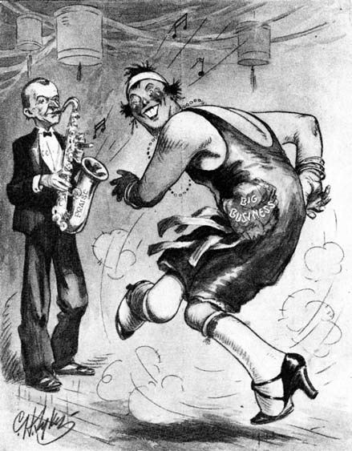
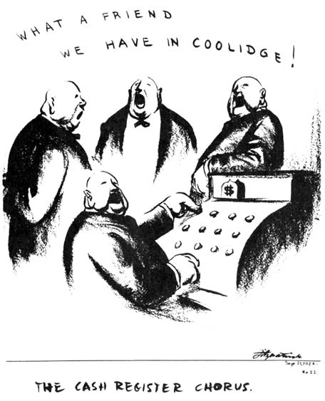
Do Now
CC
PRAISE
Big Business
Based on these cartoons, what is the relationship between President Calvin Coolidge’s administration and big business in the 1920s?

Slide 36
Reviewing for the Regents
Which is most commonly associated with the presidencies of Ulysses S. Grant and Warren G. Harding?
Depression
Corruption of public officials
Humanitarian reforms
Territorial expansion
The “boom” years of the 1920s were characterized by
A decrease in both agriculture surpluses and farm foreclosures
Limited investment capital and declining numbers of workers in the labor force
Widespread use of the automobile and an increase in buying
Increased regulation of the marketplace by both federal and state governments

Slide 37
Role of Technology
Technology, combined with new marketing strategies, best explains the transformation of American society in the 1920s
Led by Henry Ford and the automobile industry, mass production and the moving assembly line resulted in uniform products produced at lower costs

Slide 38
Role of Technology
These new technologies made possible a consumer-oriented economy, one in which more goods, costing less, were available to more Americans
Encouraged by a boom in advertising, families spent a smaller portion of their income on necessitates and a larger proportion on new consumer goods such as appliances, radios, and ready-to-wear clothing
Often these goods were purchased over time though installment buying

Slide 39
Growing Cultural Homogenization
The new technology also made American culture more homogeneous, or uniform
Americans from one coast to the other tended to use the same products, wear the same styles, see the same movies, and listen to the same music
Regional and class differences were blurred, and individualism became less important than conformity

Slide 40
Suburban Growth
With over half the population living in places with populations of more than 2,500 people, the US in the 1920s was an urban rather than a rural nation for the first time in its history
Only the Great Depression ended the building boom that was part of this growth
The automobile made it possible to draw people to suburbs that grew faster than cities
New regional, political and economic units developed, resulting in the present-day conflict between urban and suburban needs, priorities and values

Slide 41
Shifting Cultural Values
During the 1920s, American society experienced a struggle with social change as it became an urban, industrial nation
Changes in lifestyle, values, morals, and manners increased tension and conflict
Wealth, possessions, having fun and sexual freedom – ideas influenced by psychology of Sigmund Freud – were the new values

Slide 42
Leisure
With a shorter work week and with more paid vacation, Americans had more leisure time
Movies such as The Ten Commandments and the first movie with sound, The Jazz Singer, drew millions of people a week to theaters during the 1920s
Americans idolized Charlie Chaplin and other movie stars
They also admired sports figures, such as Babe Ruth
After his 1927 solo transatlantic flight, Charles Lindbergh became an overnight hero
Listening to the radio and to records were two other popular pastimes
Games such as bridge, crossword puzzles, and the board game of mah-jongg swept the country

Slide 43
Leisure
The popular image of young women in the 1920s was the flapper, a young pretty woman with bobbed hair and raised hemlines
She drank alcohol, she smoked, and she thought for herself
The flapper was featured in movies, magazines, advertising and novels such as those of F. Scott Fitzgerald
The flapper was an expression of women's new sense of independence, a statement of change and even rebellion
As such, the flappers represented another example of traditional versus modern values that was dividing the nation

Slide 44
Literature
The conflict and concern created by changing American values also saw expression in literature
American writers of the 1920s protested the effects of technology and mass consumption
They criticized the business mentality, the conformity of the times, and the preoccupation with material things
Some writers such as Ernest Hemingway, became expatriates, leaving the US to settle in Europe
Often called the Lost Generation, these writers of the twenties produced some of the most enduring works of American literature

Slide 45
Harlem Renaissance
One of the most important cultural movements of the 1920s was the Harlem Renaissance, led by a group of African American writers in the New York City neighborhood of Harlem
These creative intellectual figures – mainly well-educated members of the middle class – felt alienated from the society of the 1920s
In their works they called for action against bigotry and expressed pride in African American culture and identity
Outstanding literary figures of the Harlem Renaissance include W.E.B. Du Bois, Langston Hughes, Zora Neale Hurston, and Alain Locke

Slide 46
Harlem Renaissance
The Great Depression of the 1930s ended the Harlem Renaissance, cutting the sales of books and literary magazines
However, during the civil rights movement of the 1960s, the writers of Harlem Renaissance and their works attracted renewed interest

Slide 47
Harlem Renaissance

Slide 48
Harlem Renaissance
African American artists, musicians, and dancers also participated in the Harlem Renaissance
Black musicians in the South blended elements of African, European, and American music to create the distinctive sounds of jazz and the blues
This music was carried all over the country and abroad

Slide 49
Harlem Renaissance
Edward K. “Duke” Ellington is one of the towering figures in jazz
Ellington recorded and composed music, performed on the piano, and conducted his own orchestra until his death in 1974
Bessie Smith, known as the “Empress of the Blues,” was one of the most popular singers of the 1920s
This new music, to which people danced such daring new steps as the Charleston, became so popular that the period of the 1920s is often called the Jazz Age

Slide 50
Women’s Changing Roles
Women’s Suffrage
In 1920, the Nineteenth Amendment was ratified, giving women the right to vote
This movement began in 1848 at Seneca Falls, NY and was led by Elizabeth Cady Stanton, and Susan B. Anthony
Women in the Workforce
Throughout the 1920s, the number of women in the workforce increased steadily, by 1930 10.7 million women were working outside the home, making up 22 percent of the workforce
By 1930, women earned 40% of bachelor degrees awarded, and became teachers, nurses, and social workers – traditional female occupations
Changes in technology and scientific management created opportunities for women in white-collar and service industry jobs – secretaries, salespeople, telephone operators, and beauticians – these low-paying, low-status, and low-mobility occupations were labeled “female only,” allowing women to be hired in these positions even during hard times
The conflict between modern and traditional values in the 1920s also found expression in the contradictory roles of women

Slide 51
Women’s Changing Roles
Involvement in Politics
Health Rights, and Working Conditions
In 1920, women voted in a national election for the first time
Their vote did not have a distinctive effect on the outcome
Women did not vote in large numbers, nor did they vote as a bloc
To encourage women to play a greater part in politics, the National American Woman Suffrage Association reorganized itself as the nonpartisan League of Women Voters
Encouraged by women reformers, Congress passed the Sheppard-Towner Act in 1921 – to lower infant mortality, the law provided for health centers where women could learn about nutrition and heath care
The program came to an end in 1929 – largely because of opposition from American Medical Association

Slide 52
Women’s Changing Roles
Daily Life
Emphasis on Wife Rather Than Mother
Contrary to the image of the flapper, women were still restricted by economic, political, and social limits
Technology made life easier in the 1920s, especially for middle class women
With electric washing machines, vacuum cleaners, stoves, and refrigerators, household chores did not require so much time, and there was less need for servants
The typical homemaker now was expected to handle almost all the household tasks herself and to meet higher standards of cleanliness
The role of woman as wife received increased importance
Families changed during this period, and divorce and family planning became more acceptable
However, divorce laws continued to favor men, and wives were expected to stay at home rather than work outside the home
Family size decreased – only 20% of women who married during the 1920s had five or more children

Slide 53
Sacco and Vanzetti
Closely linked to the Red Scare was the case of Nicola Sacco and Bartolommeo Vanzetti
These two Italian immigrants – admitted anarchists – were convicted of murder in 1921 in connection with a Massachusetts robbery
Many people questioned the evidence against Sacco and Vanzetti, concluding that the two men were convicted more for their beliefs and their Italian origin than for a crime
In spite of mass demonstrations and appeals, the two men were executed in 1927
The governor of MA eventually cleared the two men in 1977

Slide 54
The Ku Klux Klan
Antiforeigner attitudes encouraged a revival of the KKK
The first organization, active during Reconstruction, had died out in the late 1800s
A reorganized Klan, formed in 1915, grew slowly until 1920
In that year, it added 100,000 members
The Klan of the 1920s targeted not only African Americans but also Catholics, Jews, and immigrants
To the Klan, the only true Americans were white, Protestant and American-born
In 1925, membership peaked at two million

Slide 55
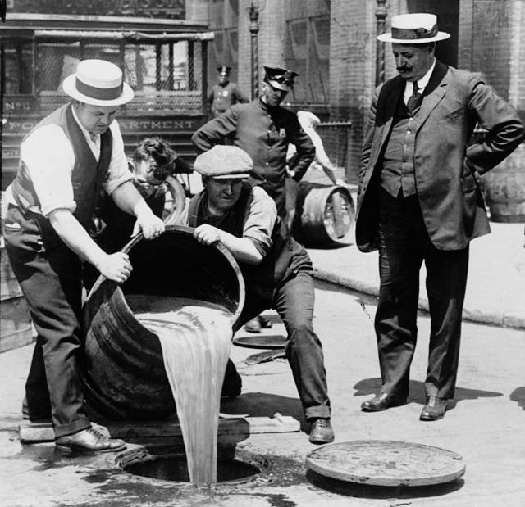

Slide 56
Prohibition
Both the rebirth of the Klan and the movement to restrict immigration reflected the struggle in the 1920s between what some saw as old, rural American values and the new values of a changing urban, industrialized culture
The clash between these two sets of values did not divide on the basis of where one lived
For example, the movement for Prohibition, a ban on the sale and consumption of alcoholic beverages, was not confined to rural American, though it received much support there

Slide 57
Prohibition
The 18th amendment, allowing Prohibition, became part of the Constitution in 1919
Congress passed the Volstead Act to implement Prohibition, but the law turned out to be unenforceable
Most Americans were simply unwilling to accept a total ban on alcohol
Furthermore, it stimulated crime, encouraging smuggling and bootlegging, the illegal manufacture and sale of alcoholic beverages
In 1933, the 21sr Amendment ending Prohibition was ratified

Slide 58
The Scopes Trial
The 1925 Scopes Trial, held in Dayton, Tennessee, received nationwide attention because it pitted the scientific ideas of Darwinian evolution against the Protestant fundamentalist view of biblical creationism
John Scopes, a biology teacher, had deliberately violated a state law forbidding anyone to teach the theory of evolution
Scopes was represented by a famous trial lawyer, Clarence Darrow
The prosecution relied on the assistance of Williams Jennings Bryan, a three-time presidential candidate and firm believer in fundamentalist Christianity
Although Scopes was convicted and fined $100, Bryan’s confused testimony weakened fundamentalist arguments

